Slide 1

Website Navigation - I
Asst.Prof.Dr.Derya BİRANT
328 - Web Based Windows Programming

Slide 2
Contents
1
MultiView
2
Wizard
3
SiteMapPath
4
Menu
3
TreeView

Slide 3
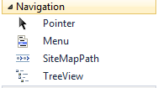
Navigation
Navigation is a fundamental component of any website.
It is necessary
  for creating a unified system
  for transfering the user from one page to another
  …
ASP.NET has a built-in navigation system:

Slide 4
Three Core Navigation Topics
The MultiView and Wizard controls:
  These let you boil down a series of steps into a single page.
  With the help of these controls, you can combine several pages of work into one place, simplifying your navigation needs.
The site map model:
  This lets you define the navigation structure of your website and bind it directly to rich controls.
The rich navigational controls (TreeView and Menu):
  Although these controls aren’t limited to navigation, they’re an ideal match.

Slide 5
Navigation Changes in ASP.NET 4
1
2
3
Routing: It’s now possible to use routing to process URLs and redirect requests to a suitable web form. It allows search engines to discover and index the content of your web site more easily.
A more flexible Wizard: The Wizard control supports a new LayoutTemplate that gives you even more control if you want to replace its built-in layout with your own design.
A more standardized Menu: The Menu control now creates its output using a list
with a proper set of CSS styles, rather than an HTML table.

Slide 6
Pages with Multiple Views
Most websites split tasks across several pages.
It is necessary to transfer information from one page to another.
Multiple Views can be used to embed the code for several different pages inside a single page.
  MultiView
  Wizard
They allow to handle a small multistep task without worrying about how to transfer the relevant information between web pages.

Slide 7
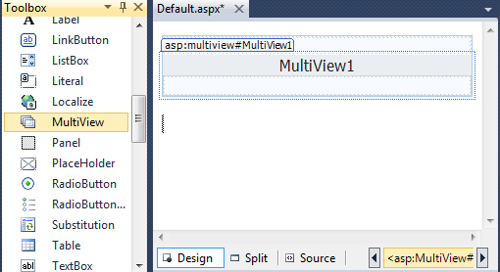
The MultiView Control
MultiView gives you a way to declare multiple views and show only one at a time.

Slide 8
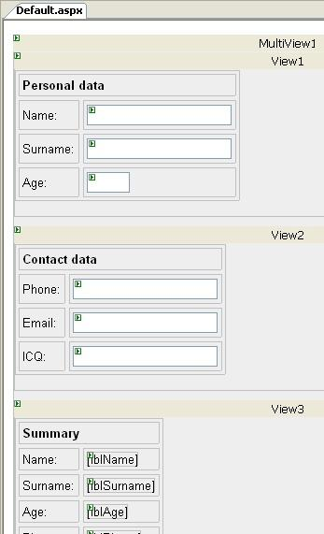
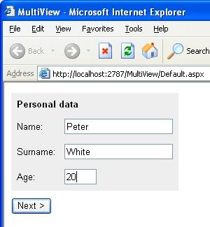
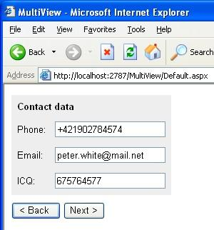
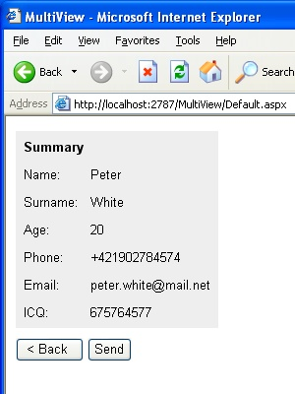
MultiView Example

Slide 9
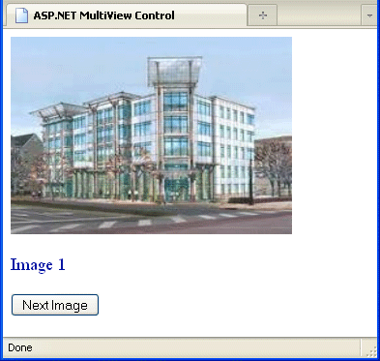
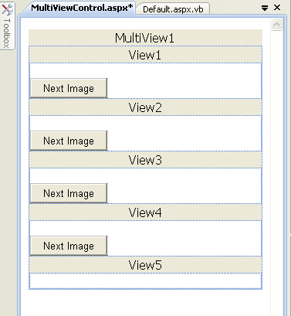
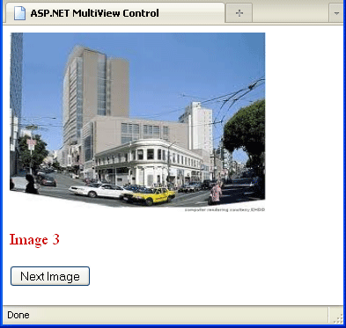
MultiView Example

Slide 10
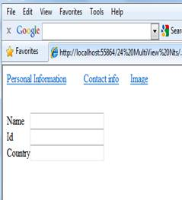
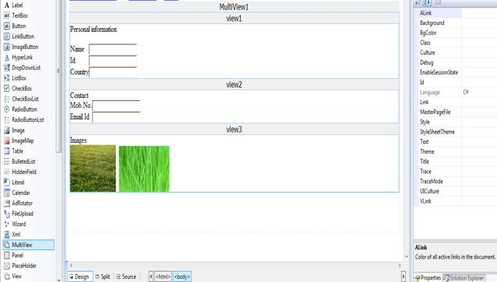
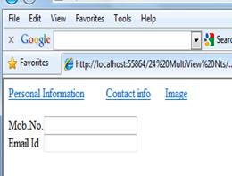
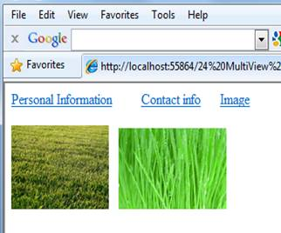
MultiView Example

Slide 11
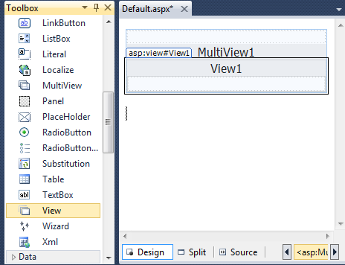
Adding Views to MultiView Control
Drag and drop View control

Slide 12
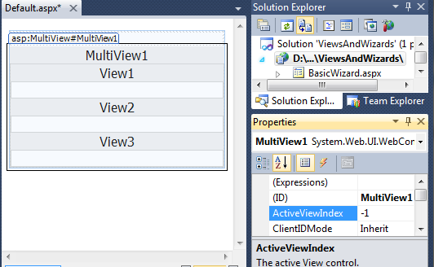
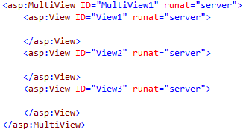
MultiView Control
MultiView.ActiveViewIndex determines what view will be shown.
This is the only view that’s rendered in the page.
The default value is -1, which means no view is shown.

Slide 13
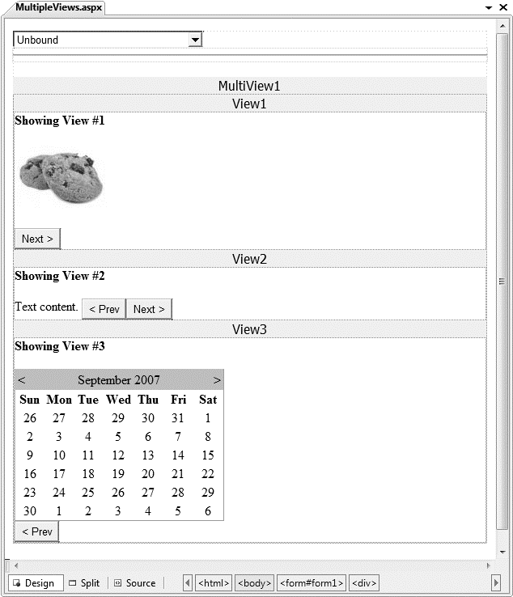
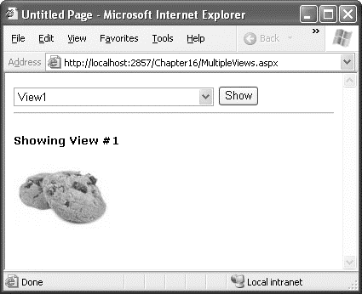
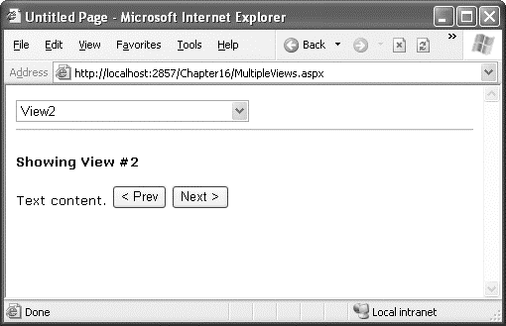

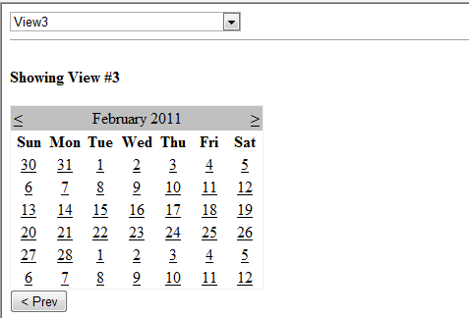
At design time
At runtime

Slide 14
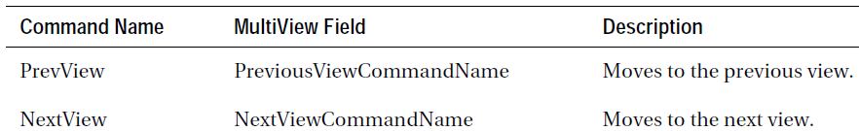
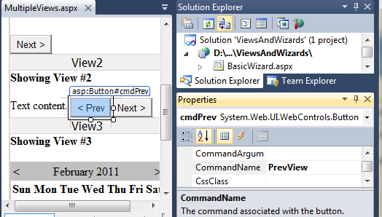
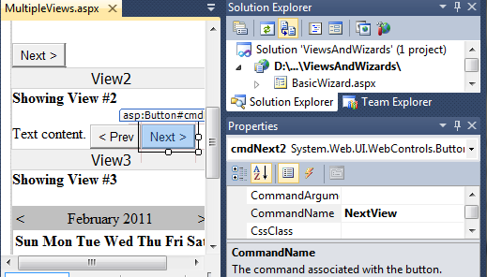
Prev and Next Views

Slide 15
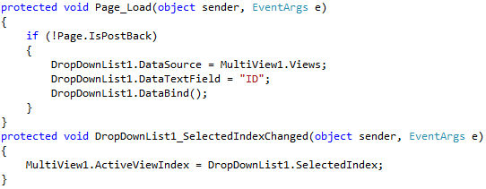
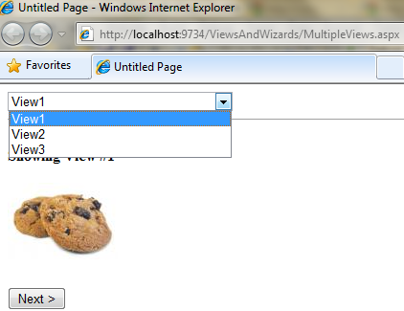
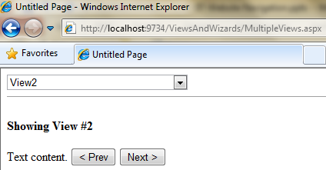
Dynamically Change View
Sample code that binds the list of views to a dropdownlist:

Slide 16
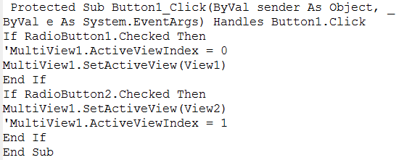
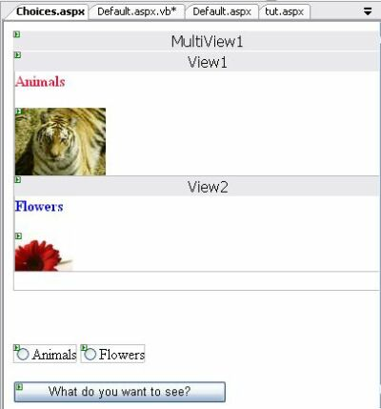
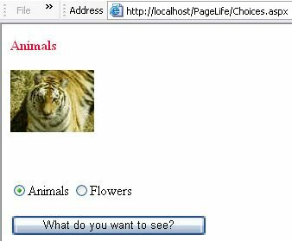
Dynamically Change View

Slide 17
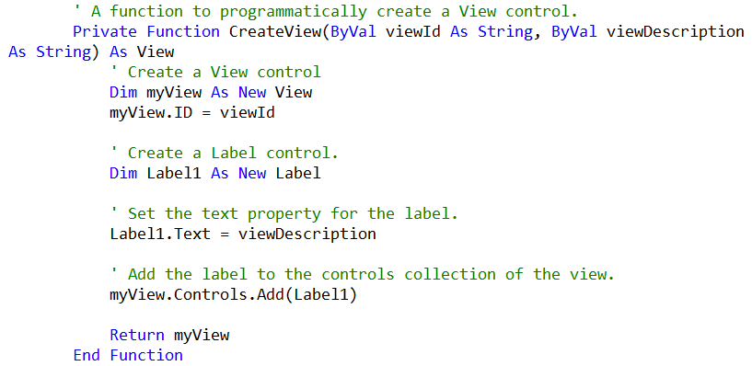
Dynamically Create a View
Create a view in code

Slide 18
The Wizard Control
The Wizard control is a more glamorous version of the MultiView control.
It also supports showing one of several views at a time, including navigation buttons, a sidebar with step links, styles, and templates.
Notes:
Glamorous: Çekici, göz alıcı, büyüleyici

Slide 19
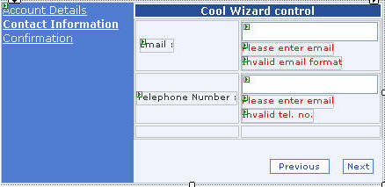
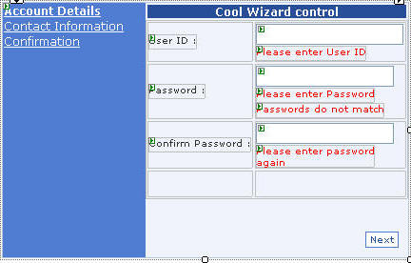
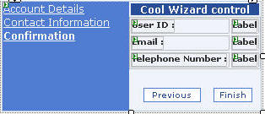
The Wizard Control
Usually, wizards represent a single task, and the user moves linearly through them, moving from the current step to the one immediately following it.

Slide 20
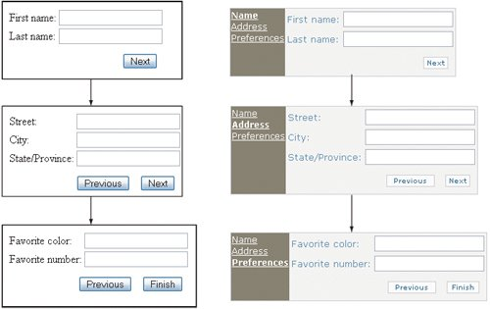
Wizard Example

Slide 21
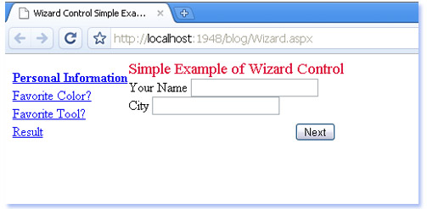
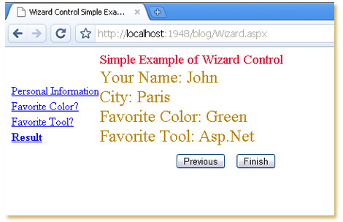
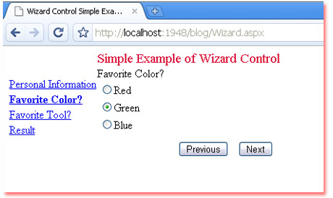
Wizard Example

Slide 22
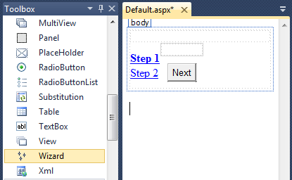
Adding new Wizard Control
Drag and drop a wizard control to the webform

Slide 23
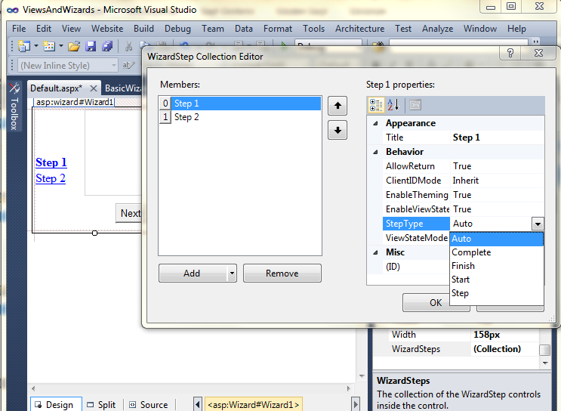
Adding Steps to Wizard

Slide 24
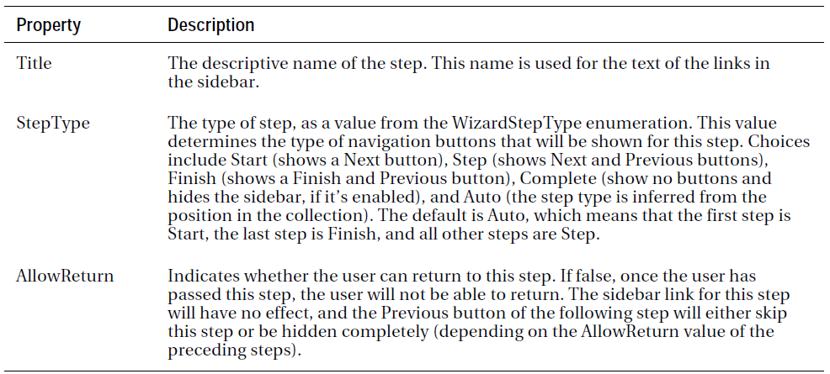
WizardStep Properties

Slide 25
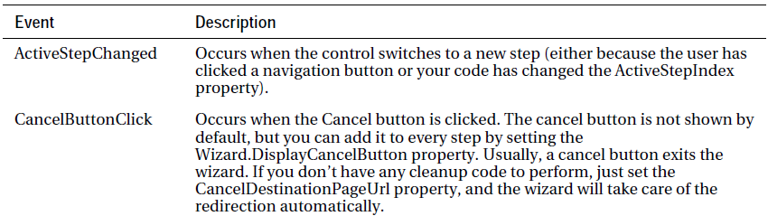
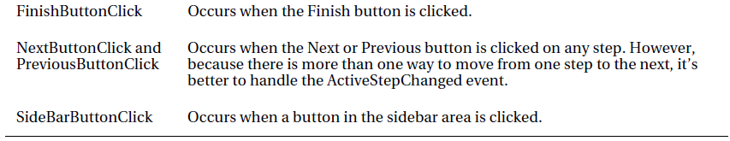
Wizard Events

Slide 26
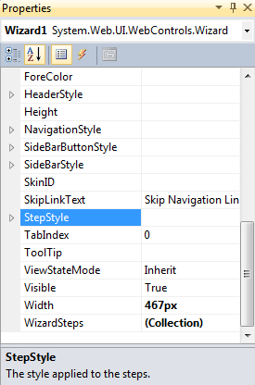
Wizard Styles
It is possible to customize wizard appearance.
You can control the colors, fonts, spacing, and border style etc.

Slide 27
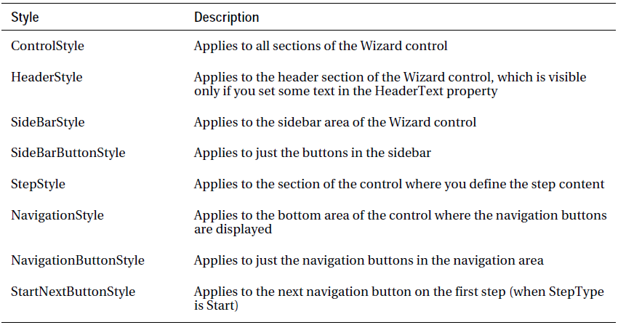
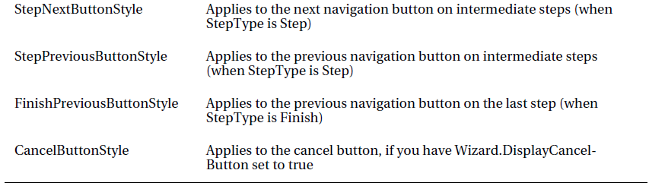
Wizard Styles

Slide 28
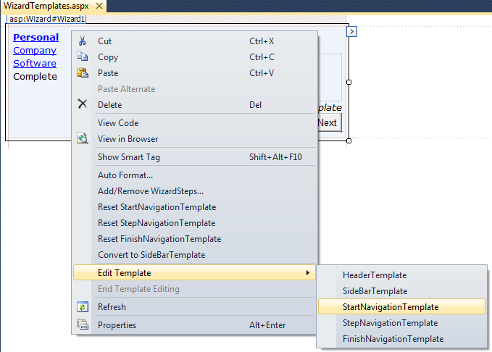
Wizard Templates

Slide 29
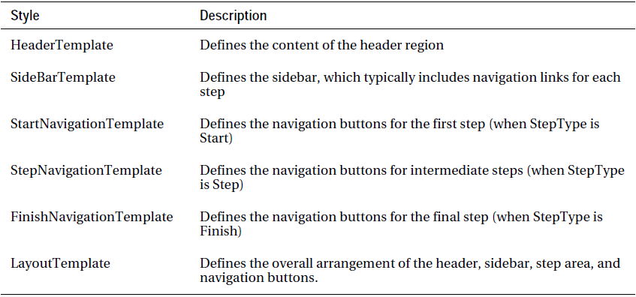
Wizard Templates

Slide 30
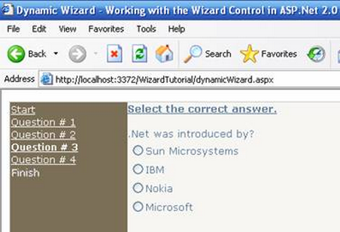
Wizard Example
Test Questions

Slide 31
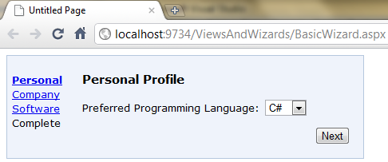
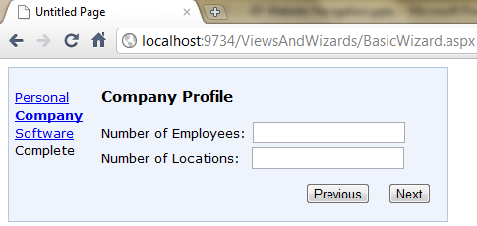


Let’s do it!

Slide 32
See you next week!
Asst.Prof.Dr.Derya BİRANT
328 - Web Based Windows Programming

